Slide 1




Transport Analytics: Flights and Ports
Team Members: Antariksh Ramesh
Brunoo Medaballimi Bosco
Prithviraju Venkataraman
Rishitha Kandibyalla
IS699 - Information Systems Project

Slide 2

WHY FOCUS ON TRANSPORTATION SYSTEMS?
01.
02.
03.
Transportation systems are essential for global trade and connectivity.
Flight delays and port congestion have significant ripple effects, increasing costs and impacting supply chains.
Efficient transportation is critical for meeting growing global demands.

Slide 3

INTRODUCTION
In this project, we will explore critical insights derived from a large-scale analysis of flight and port activity data.
The goal is to provide a comprehensive understanding of transportation and trade trends, uncover potential bottlenecks, and identify opportunities for efficiency improvements.
By examining the patterns and trends in the aviation and port activity sectors, we aim to enhance our understanding of logistical flows and contribute to data-driven decision-making.

Slide 4
OBJECTIVES
01
Predict Flight Delays
02
Analyze Port Congestion
Use structured data like weather, schedules, and historical delays to build models for accurate delay predictions.
Identify congestion patterns using variables like cargo volumes and vessel types to optimize resource allocation.
03
Provide Real-Time Congestion Insights
04
Integrate Structured and Unstructured Data
Combine historical trends from structured data with live conditions from imagery for a holistic understanding.
Leverage aerial imagery & deep learning models to detect runway and port congestion in real time.

Slide 5
DATASET OVERVIEW
TABULAR DATA
IMAGE DATA
1. Flight Dataset: Includes variables like weather, air time, and delays.
2. Port Dataset: Tracks cargo volumes, vessel types, and port calls.
1. Planes in Satellite Imagery: Over 32,000 aerial images with airplane labels.
2. Ships in Aerial Images: Annotated images with bounding boxes around ships.

Slide 6
Target Variables
Port Dataset
Flight Dataset
Import_Cargo:
Measures the volume of cargo handled at ports, serving as an indicator of port throughput and efficiency.
Air_Time:
Tracks the actual time spent in flight, which helps analyze punctuality and factors affecting flight duration.

Slide 7


DATASET PREPROCESSING
TABULAR DATA
IMAGE DATA
Handled missing values using interpolation.
Added seasonal features to capture trends.
Applied log transformations to handle skewed variables like cargo volumes.
Resized images to 224x224 pixels for compatibility with CNNs and RNN.
Used data augmentation (e.g., flipping, rotation, brightness adjustments) to enhance model robustness.

Slide 8

METHODLOGY OVERVIEW
Tabular Data Models
Random Forests and Gradient Boosted Trees for flight delay and port activity predictions.
Image Based Models
LSTMs to capture sequential patterns in flight delays.
(detecting airplanes).
Hybrid Models
Combined tabular and image data for enhanced predictions of port congestion.

Slide 9
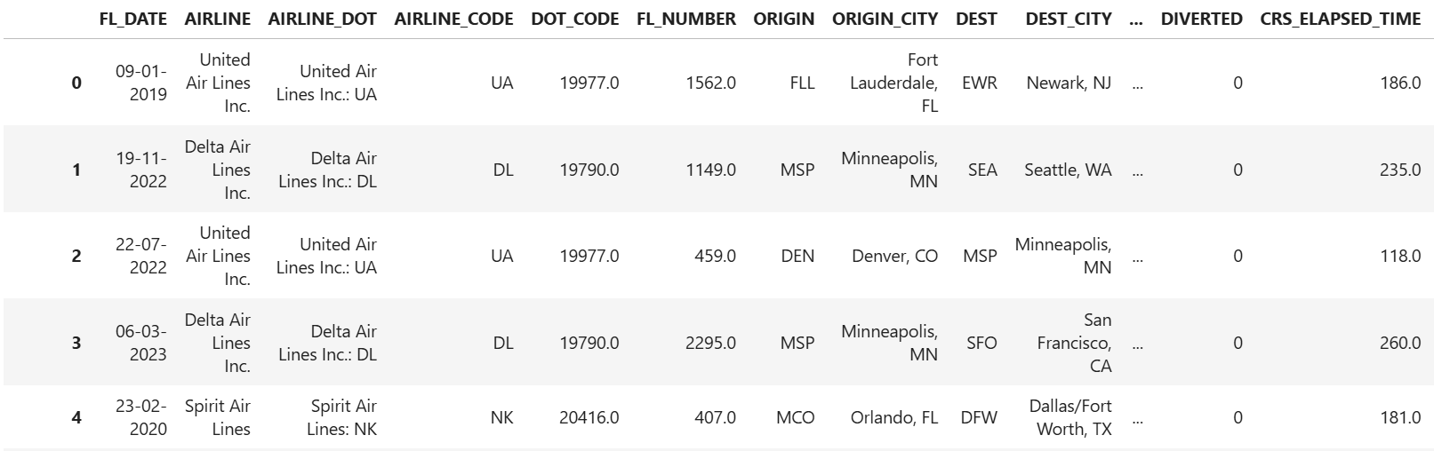
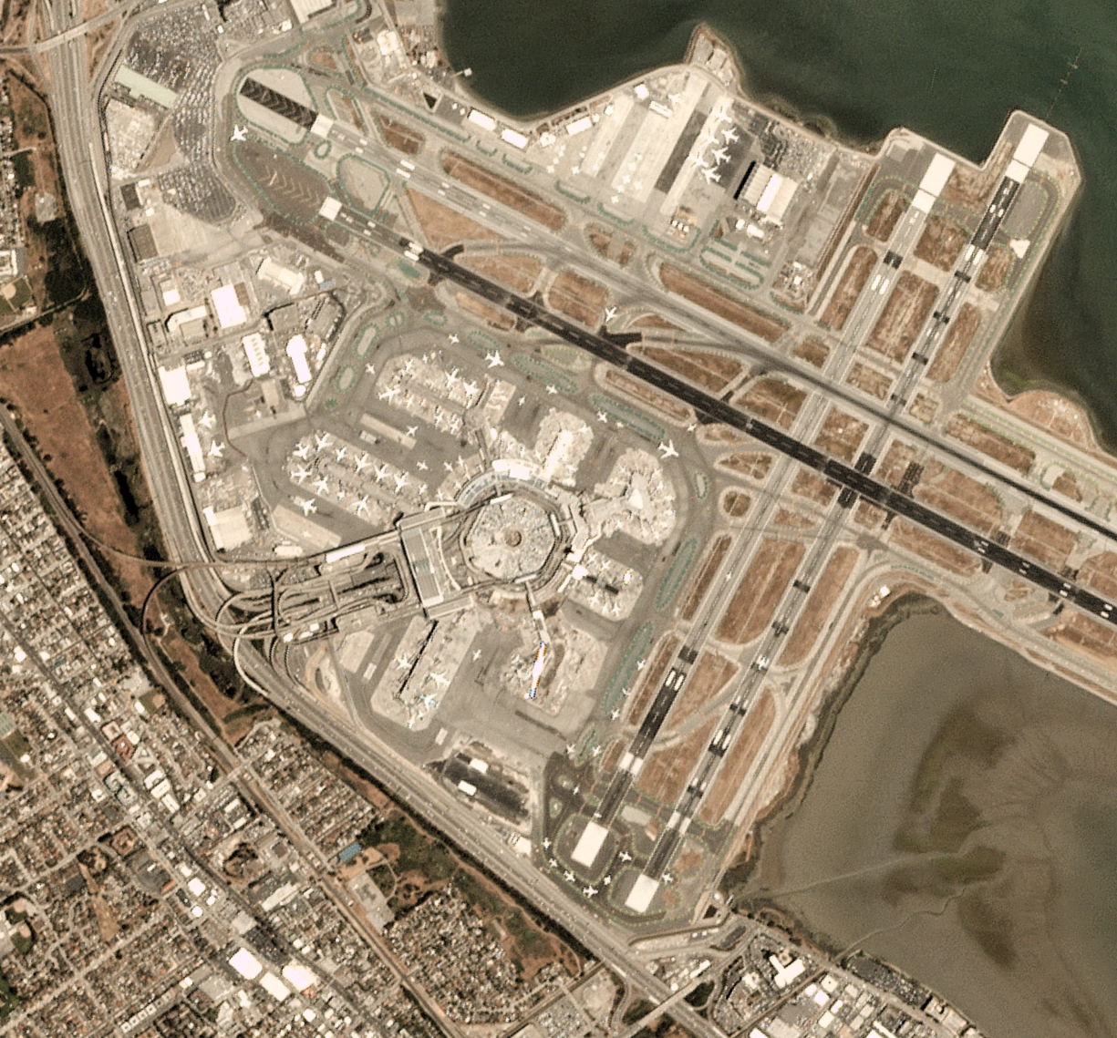
FLIGHT DATASET OVERVIEW
IMAGE
DATA
TABULAR DATA

Slide 10

FLIGHT ANALYSIS RESULTS
Models achieved an R² of 0.85, explaining 85% of the variability in arrival delays.
Weather and distance were the most significant predictors.
Seasonal analysis confirmed that delays spike during winter months.
RNN-LSTM handles sequential dependencies better, making it ideal for datasets like flight delays where sequences (e.g., time of flight, preceding events) impact outcomes.

Slide 11
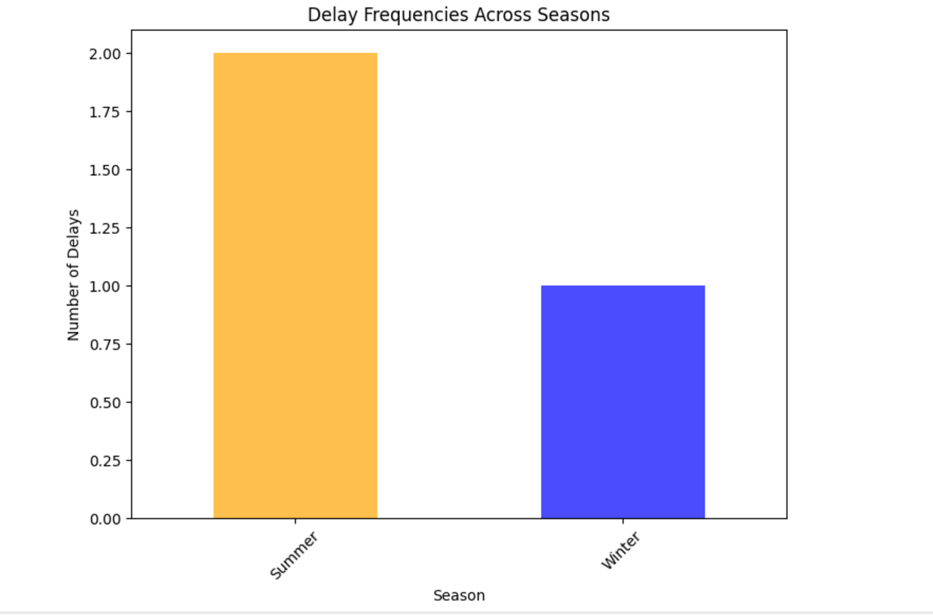
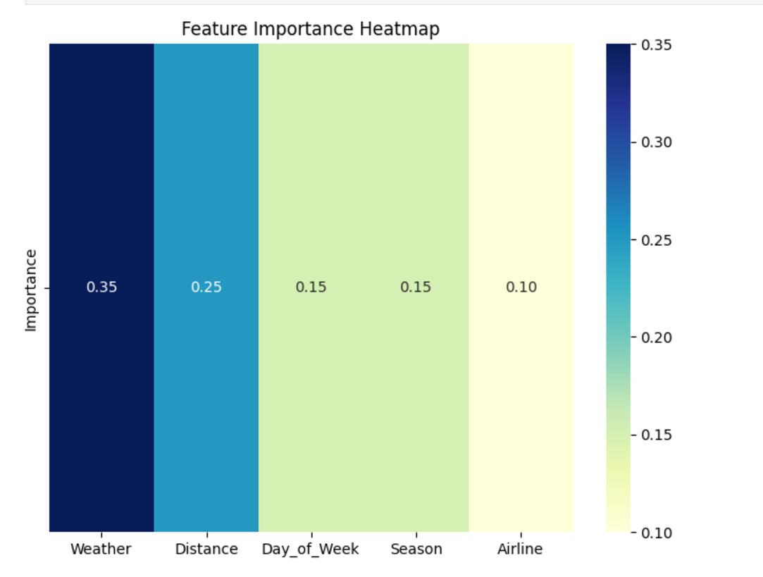
FLIGHT ANALYSIS RESULTS

Slide 12
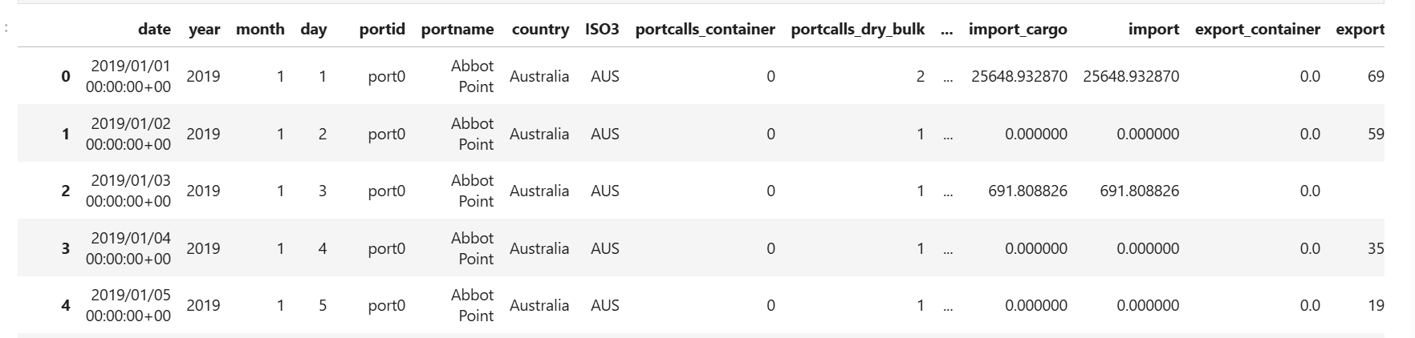
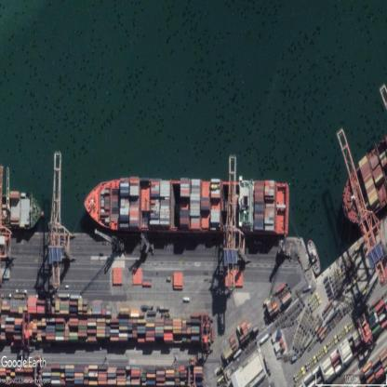
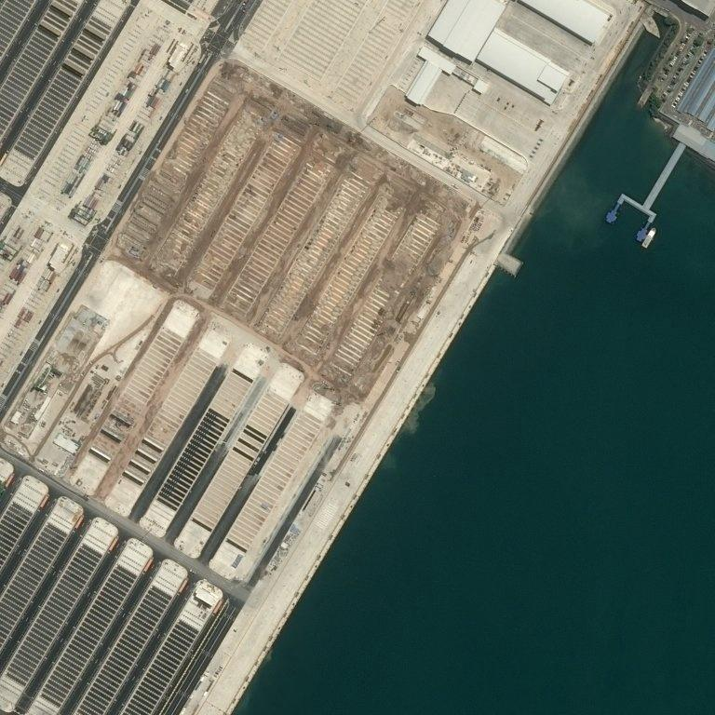
PORT DATASET OVERVIEW
TABULAR DATA
IMAGE
DATA

Slide 13
PORT ANALYSIS RESULTS
Regression models explained 80% of the variance in cargo volumes.
Hybrid models (tabular + image data) outperformed standalone models in predicting congestion.
Seasonal trends showed peak cargo volumes in Q3, requiring better resource allocation.

Slide 14
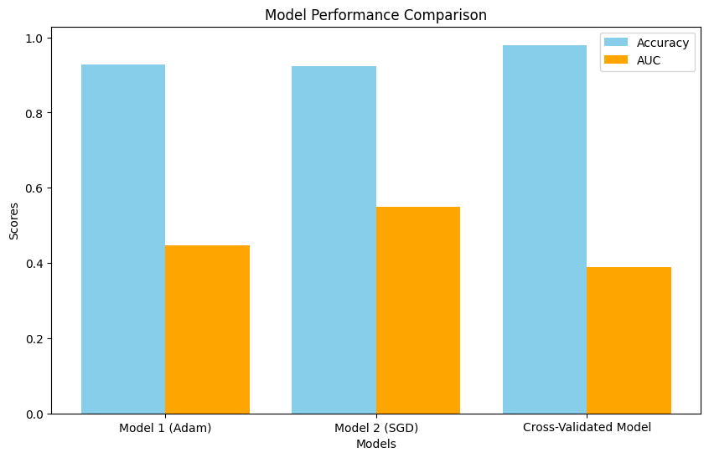
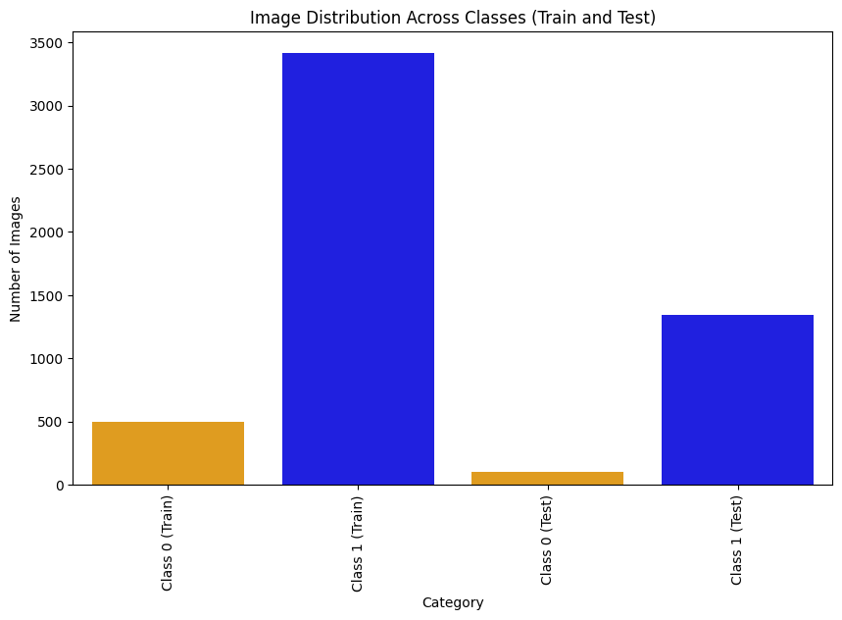
PORT ANALYSIS RESULTS

Slide 15
KEY OUTCOMES
Importance of Sequential Data:
02
Weather Importance:
01
Weather conditions and resource allocation were the most influential features in predicting port and flight delays.
RNN-LSTM outperformed simpler models due to its ability to effectively handle sequential dependencies in the data
03
High Performance
Demonstrated strong performance compared to traditional models (e.g., Random Forest, Gradient Boosted Trees).

Slide 16


CHALLENGES
Need for predictive and real – time tools to address these challenges.
Cascading flight delays disrupt schedules, causing operational inefficiencies and passenger dissatisfaction.
Seasonal peaks and bottlenecks during busy trade periods result in long wait times for cargo handling.
Aging infrastructure in airports and ports struggles to keep up with increasing demand, leading to congestion, delays, and reduced efficiency.

Slide 17

FUTURE SCOPE
Incorporate Real-Time Data Sources
Leverage advanced models like BERT or
Vision Transformers to process sequential
and multimodal data effectively.
Example: Analyze flight schedules with
runway images for accurate delay predictions..
Explore Transformer-Based Architectures
Integrate live feeds like real-time data,
weather updates for dynamic,
real-time predictions.
Example: Ports use live ship tracking data;
airlines adjust schedules based on runway activity.
Enhance Interpretability and Usability
Use techniques like Grad-CAM and feature importance rankings
to make insights actionable and accessible for stakeholders.
Example: Highlight congestion on port maps or runway visuals
for quick decision-making.
.

Slide 18
CONCLUSION
Holistic Approach: Combining structured and unstructured data provides a comprehensive understanding of transportation inefficiencies.
ML and DL Models: Machine learning excelled in predicting delays, while deep learning provided real-time visual insights into congestion.
Scalability: The methodology is adaptable for broader applications in logistics, rail networks, and urban traffic management.
Practical Applications:
Airlines can optimize schedules and improve passenger satisfaction by reducing delays.
Ports can allocate resources effectively during peak periods and minimize bottlenecks.

Slide 19
THANK YOU

